Slide 1
Accessibility 101 for PowerPoint
The fourteen things you can do to make your presentations more accessible for people with disabilities
Notes:
Checklist item #1: Add metadata
Checklist item #2: Use a built-in slide layouts

Slide 2
Use built-in slide layouts and titles
Slide layouts are pre-approved for screen readers and other accessibility devices
Slide titles allow screen readers to scan, like headings in Word
Notes:
Checklist item #2: Use built-in slide layouts for tables, charts, graphs, etc.
Checklist item #3: Use built-in slide titles

Slide 3
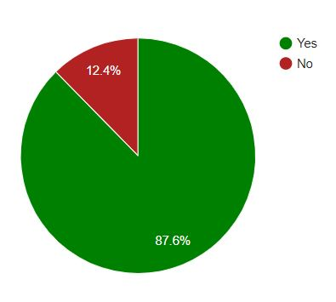
Graphics, alt text, and colors
♣ Use alt text for all graphics
♣ Use high-contrast colors
♣ Don’t use color to convey meaning
Percentage of screen reader use due to a disability
Notes:
Checklist item #4: Use alt text for images
Checklist item #5: Use high contrast colors
Checklist item #6: Use another way to convey meaning besides color
Also … Checklist item #2: Use built-in slide layout

Slide 4
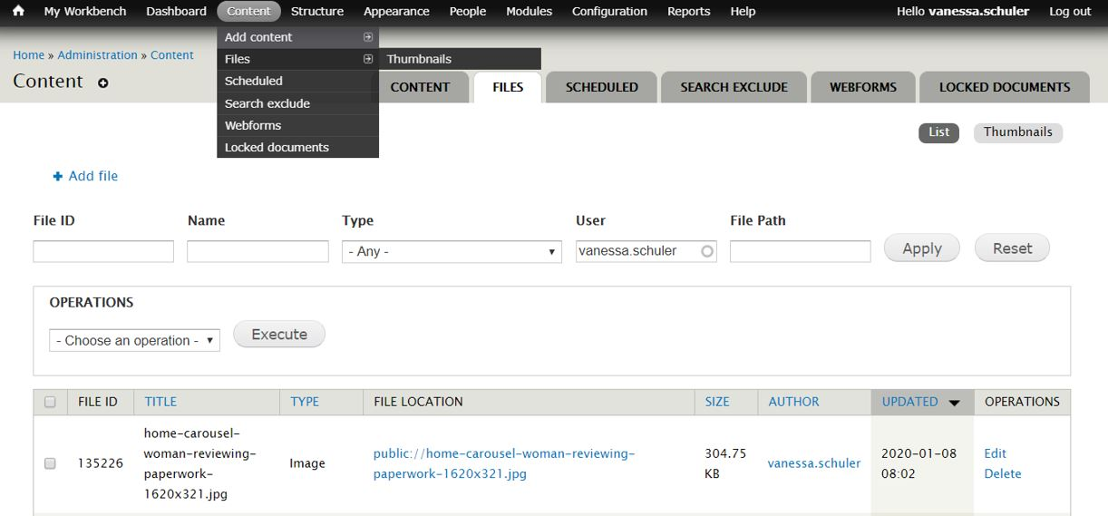
Layered graphics—avoid ‘em
Notes:
Checklist item #7: Avoid layered graphics
Checklist item #8: Ensure proper reading order
Also … Checklist item #10: Use built-in bullets and numbering

Slide 5
Animations and transitions
Why use?
Why not use?
Fun
Visual interest
Emphasize content
Can make viewers sick or cause seizures
Screen readers can miss content
Notes:
Checklist item #9: Be careful with animations and transitions
Also … Checklist item #8: Proper reading order

Slide 6
Link text? Make it descriptive.
University of Washington, Creating Accessible Presentations in Microsoft PowerPoint - https://www.washington.edu/accessibility/documents/creating-accessible-presentations-in-microsoft-powerpoint/
WebAIM, PowerPoint Accessibility - https://webaim.org/techniques/powerpoint/
Notes:
Checklist item #10: Use descriptive link text
Checklist item #11: Use built-in bullets and numbering

Slide 7
Use tables properly
Name | Email | Training date | Training complete | Certificate delivered
Jane Doe | thedoes@wherever.com | 1/1/2020 | Y | Y
John Doe |  | 3/1/3030 | N | N
Bob Doe | bdoe@somewhereelse.com | 1/1/2020 | Y | Y
Notes:
Checklist item #12: Set up tables properly
Also … Checklist item #13: Run the Accessibility Checker
And … Checklist item #14: Setup PDF Save for structure tags

