Slide 1


Navigating the Pandemic
Presentation for BUILD Black History Month

Slide 2


Community Resources

Slide 3

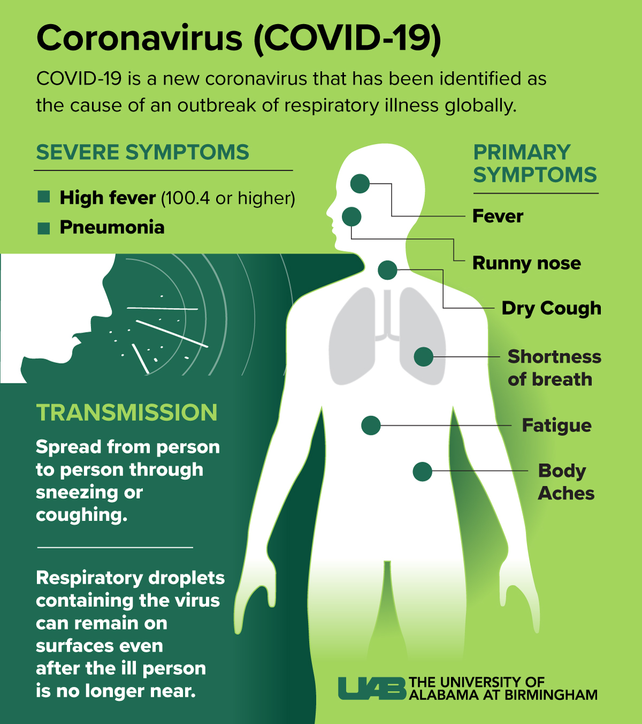

Accessing COVID-19 testing and vaccination?
Washington Department of Health has links for testing and vaccination sign up.
If you think you were exposed, or if you have symptoms of COVID, look up where to get tested:
DOH Testing Information
If you want to register for the COVID-19 vaccination:
DOH Vaccination Link

Slide 4

Help for Small Businesses
Coronavirus (COVID-19): Small Business Guidance & Loan Resources
Health and government officials are working together to maintain the safety, security, and health of the American people. Small businesses are encouraged to do their part to keep their employees, customers, and themselves healthy.
Notice: Paycheck Protection Program resumed January 11, 2021.
SBA, in consultation with the U.S. Treasury Department, reopened the Paycheck Protection Program (PPP) for First Draw Loans the week of January 11, 2021.
https://www.sba.gov/page/coronavirus-covid-19-small-business-guidance-loan-resources

Slide 5

Unemployment
Affected by COVID-19 – comparing pre-pandemic to now
2019 Unemployment rates 4th quarter nationally:
3.3 percent
5.8 percent for Black Americans
2020 Unemployment rates 4th quarter nationally:
6.5 percent
9.9 precent for Black Americans
Federal stimulus updates
On Dec. 27, 2020 the federal stimulus that changes and extends CARES Act unemployment benefits was signed into law. Visit the esd.wa.gov/newsroom/covid-19 for the latest info.
On Dec. 27, 2020, Gov. Jay Inslee announced a one-time payment of $550 to many recipients of Pandemic Unemployment Assistance (PUA).
To apply for this program or other unemployment programs:
https://esd.wa.gov/unemployment

Slide 6

Employment Opportunities
BUILD holds job listings and workshops in Leadership:
https://www.buildwa.org/blog/category/job
State of Washington Employment:
http://careers.wa.gov/
Seattle Foundation Blog: Recognizing & Maximizing Black Leadership:
https://www.seattlefoundation.org/Blog/Articles/2018/02/black-leadership
African American Affairs Employment Opportunities:
https://caa.wa.gov/employmentopportunities

Slide 7

Paid Family & Medical Leave Act
Paid Family and Medical Leave is here for you when a serious health condition prevents you from working, when you need time to care for a family member or welcome a new child, or for certain military-related events.
As with any illness, to be eligible for paid medical leave, a healthcare provider must certify that you are unable to work due to a serious health condition. If your healthcare provider certifies your illness meets the definition of “serious health condition” and you are otherwise eligible, you can use Paid Family and Medical Leave for COVID-19 cases.
https://paidleave.wa.gov/

Slide 8

Housing Assistance during COVID-19
The Washington State Department of Financial Institutions (DFI) protects consumers and advances the financial health of Washington State by providing fair regulation of financial services and educating consumers to make informed financial decisions.
COVID-19 Mortgage Relief and Assistance
Homeownership counseling and assistance is available to Washington residents.
Homeowners in distress may call DFI’s toll-free number 1-877-RING-DFI (746-4334) to talk to a member of our team and to get assistance in how best to contact their mortgage servicer, and to learn more about their options.
If you would like to talk to a housing counselor, call the Washington Homeownership Hotline at 1.877.894.HOME.

Slide 9


Difficulty with Rent?
If you are unable to pay rent due to COVID-19, you may qualify for rental assistance through one of the eviction rent assistance programs in your county.
Find out more here:
Washington State Department of Commerce Rent Assistance webpage.
Eviction Rent Assistance Program (ERAP)/Treasury Rent Assistance Program (T-RAP)
New funds announced by Gov. Inslee on Feb. 11 have not been distributed to service providers yet. They are working as fast as we can to amend contracts and will update this announcement soon.

Slide 10

Food Assistance
DSHS offers food stamps assistance the SNAP (Supplemental Nutrition Assistance Program, a federally funded program. Family income limits, and food assistance amounts, have increased during COVID. To apply contact:
https://www.washingtonconnection.org/home/ or call 877-501-2233
Family Size | Monthly
1 | $2,127
2 | $2,873
3 | $3,620
4 | $4,367
5 | $5,113
6 | $5,860
7 | $6,607
8 | $7,354

Slide 11
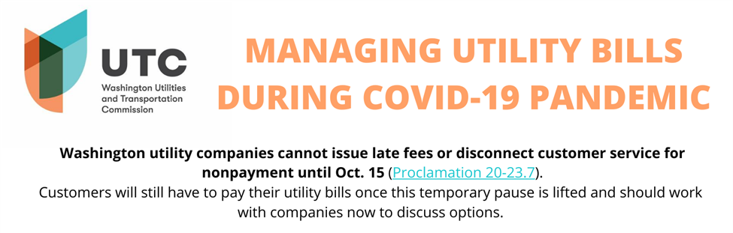
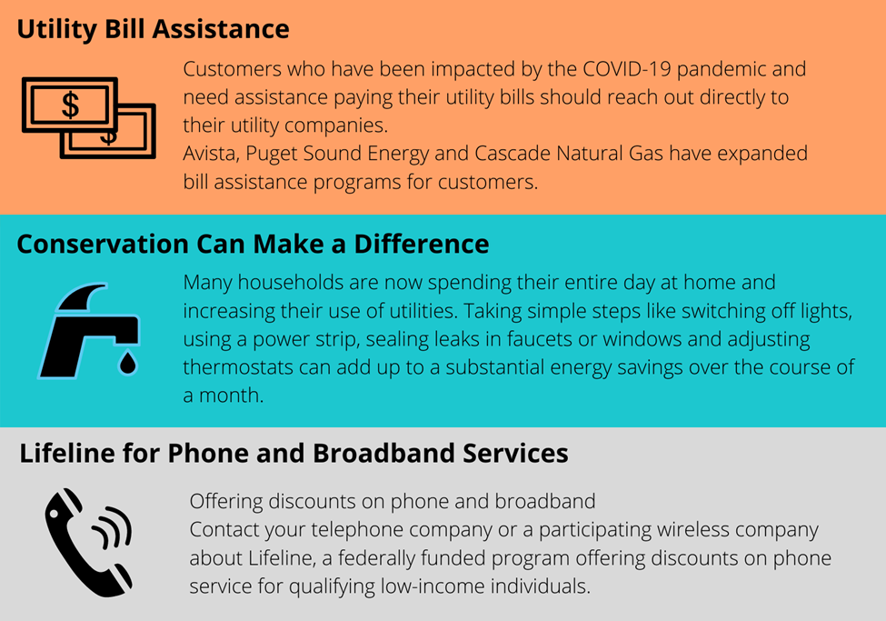
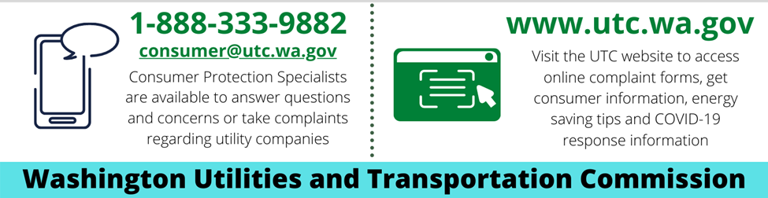
LIHEAP (Low Income Home Energy Assistance Program may have assistance available for bills to those who qualify. Applications can be found through your county assistance program: https://fortress.wa.gov/com/liheappublic/map.aspx

Slide 12


Education from Home
Resources Online
Students Helping Seattle: Visit www.studentshelpingstudentsseattle.com to volunteer to become a tutor or to join the waiting list to be matched with a tutor.
Pierce County Library System:
Online Homework Help - Online tutors are available every day* from 1 - 10 p.m., for one-on-one homework help. Live FAFSA help is also available. https://www.piercecountylibrary.org/kids-teens/tools-students/online-homework-help.htm
Youth Tutoring Program – Catholic Community Services
Statewide resources https://ccsww.org/get-help/child-youth-family-services/youth-tutoring-program/

Slide 13

Education from Home Resources Online
League of Education Voters Resources for Online Learning. https://educationvoters.org/resources/covid-19-resources/
Everyone On- Low Cost Internet Service and Computers https://www.everyoneon.org/find-offers
50 Local Free high speed Wi-Fi Locations is not available https://www.tacomalearns.org
COVID-19 Resources for King County https://www.kingcounty.gov/depts/health/covid-19/schools-childcare.aspx
Thurston County Public School Resources https://www.nthurston.k12.wa.us/keeplearning
Thurston County Internet Access Program https://www.nthurston.k12.wa.us/freeinternet

Slide 14

Mental Health Resources
  Employee Assistance Program
  To access EAP counseling services, complete an Online Referral Request or call 877-313-4455.
  EAP also offers webinars like: Navigating Change, Self-Care, Working from Home, Working with People in Crisis
NAMI Washington
If you are experiencing a mental health emergency, please call the Crisis Clinic at 866-427-4747 OR 206-461-3222
Crisis Text Line: crisistextline.org - text
Software Apps that can help
  Do It Online with www.talkspace.com
  Teen Link: call or text 866-833-6546
  Sleep more. Stress less. Live better with www.calm.com
  HowRightNow.org
  Happify

Slide 15
  Suicide Hotline
  Help is available.
  Speak with someone today!
  800-273-8255
Suicide Prevention LifelineExternal1-800-273-8255
OK2Talk Helpline Teen HelplineExternal1 (800) 273-TALK
Crisis Text Line Text SIGNS to 741741 for 24/7, anonymous, free crisis counseling
If you need someone to talk to about stress due to COVID-19, call Washington Listens at 1-833-681-0211. Someone is available to talk from Monday – Friday, 9 a.m. to 9 p.m. and weekends from 9 a.m. to 6 p.m. TTY and language access services are available.
Warm Line for people living with emotional and mental health challenges: 877-500-WARM (877-500-9276)
WA State Behavioral Health Toolbox for Families. https://www.doh.wa.gov/Portals/1/Documents/1600/coronavirus/BHG-COVID19-FamilyToolbox.pdf

Slide 16
More SmartApss
Healthy Minds Program app for skill-based meditation learning
Care for your coronavirus anxiety — a project by Shine Connections
HowRightNow.org
Headspace guided meditation, articles and videos
Stop, Breathe & Think meditation and mindfulness app
COVID Coach from the U.S. Department of Veterans Affairs

Slide 17
